Slide 1

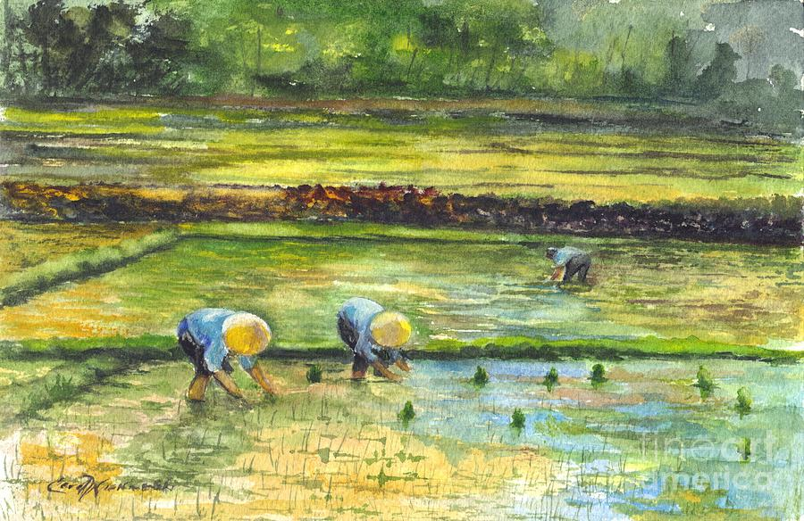
Agri & AI
Connecting Farmers with Tech
Using Artificial Intelligence to Predict Crop Prices
A simple Interface to Solve Crop Prediction Problem with guaranteed benefits to Poor Farmers

Slide 2

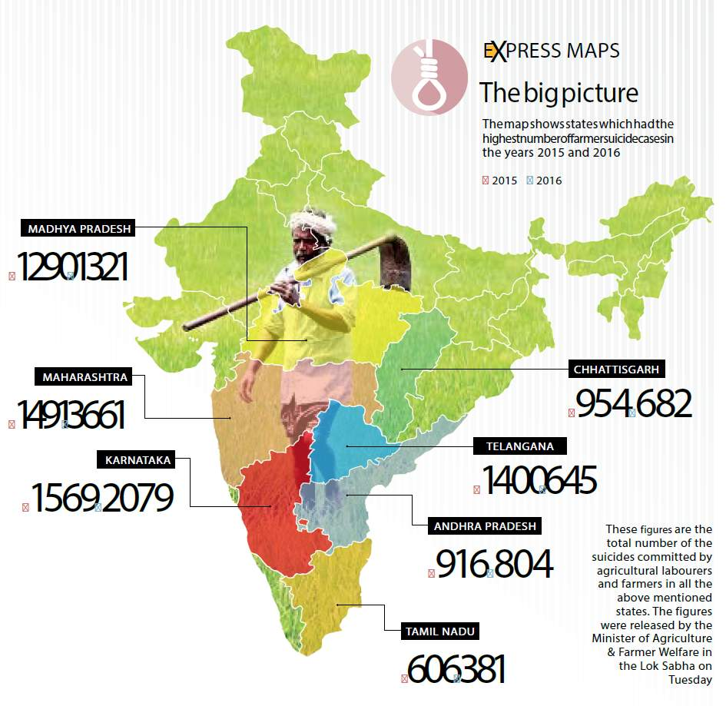
Problem Addressed
Farming is a tedious job, it not only requires physical labor but business and strategies.
Farmers often find themselves in a fix while managing all these together and often end up giving their lives.

Slide 3






Our Approach
Customer support to help yield better crop and accurate estimation of price.
Graphical Representation of crop production for easy understanding.
24×7 Messaging Service to solve all queries.
One to One Assistance to help Farmers gain more knowledge.
No third party involvement.

Slide 4






Unique Proposition Value
Live Updates
Precise Prediction
User Friendly
Gives Better Understanding of Market
Free of Cost for Farmers

Slide 5
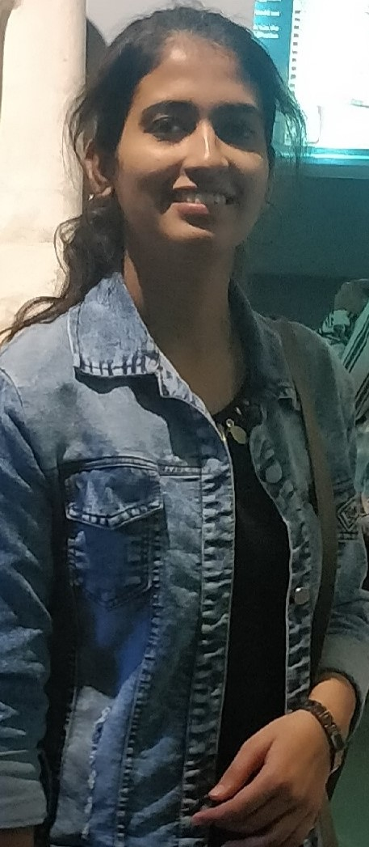

Team Members:
We are a duo of Girls driven by the desire to save the Poor Indian Farmers from Financial Crises
Aditi Naithani
Bhanvi Menghani

